Slide 1



Take a seat!
We’ll start at 7:05pm <3
DATA
Intro to Python + Data
Intro to Python + Data

Slide 2




What is Python?
Commands
Outcome

Slide 3
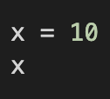



Basic Functionalities
Set Variables
Do Basic Math

Slide 4
What is Data?
Data is everything!
It can take the form of surveys, a bunch of numbers, etc.
BUT… we have to differentiate TYPES of data
For example: We could do 2 + “Hello” in Python… let’s try it 😈

Slide 5

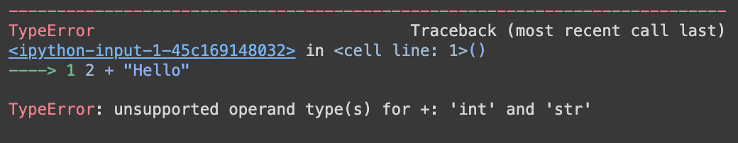


⁉️

Slide 6
Data Types
Type | Name in Python | Description | Examples
Integers | ‘int’ | Whole numbers | -1, 0, 1, 2, 3…
Floats | ‘float’ | Decimals | 2.5, 6.125, 1.0
Strings | ‘str’ | Letters, words, and sentences (or anything surrounded by quotes) | “A”, “Hello!”, “12345”
Booleans | ‘bool’ | True/False | True, False
Lists | ‘list’ | Collections of items surrounded by brackets [ ] | [1, 2, 3] [“Hi”, 1.5] [[1, 2, 3], “HI”]
Dictionaries | ‘dict’ | Collections of items assigned to labels, called “keys” | {“Colors”: [“red”, “blue”], “Numbers: [1,2,3]”}

Slide 7

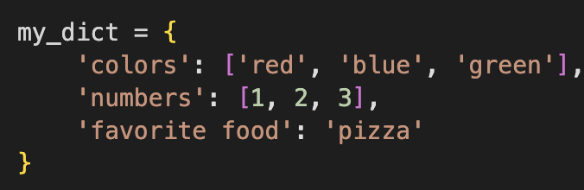
Data Types
Lists (‘list’):
Collections of items surrounded by brackets [ ]
Dictionaries (‘dict’):
Collections of items assigned to labels, called “keys”. Surrounded by curly brackets { }

Slide 8




Indexing
Indexing means to retrieve an element from a collection (such as lists or dictionaries)
Indexing from a List:
(we start from 0!)

Slide 9




Indexing
Indexing means to retrieve an element from a collection (such as lists or dictionaries)
Indexing from a Dictionary:

Slide 10
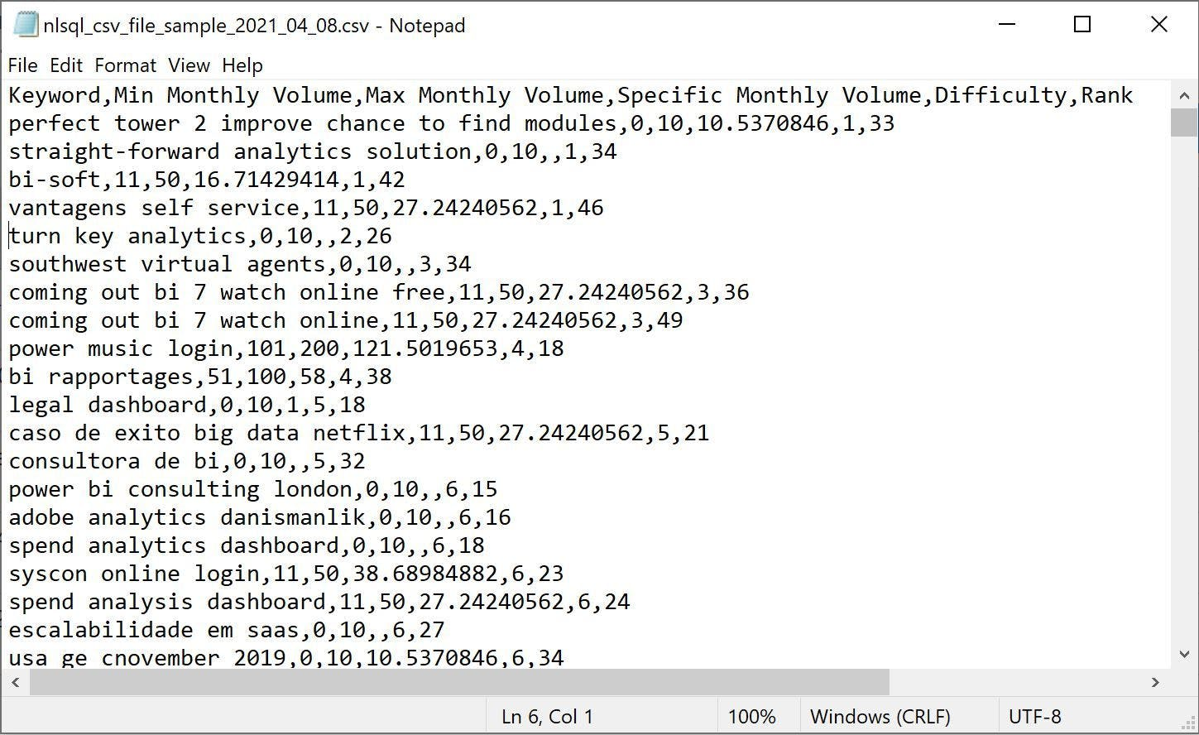
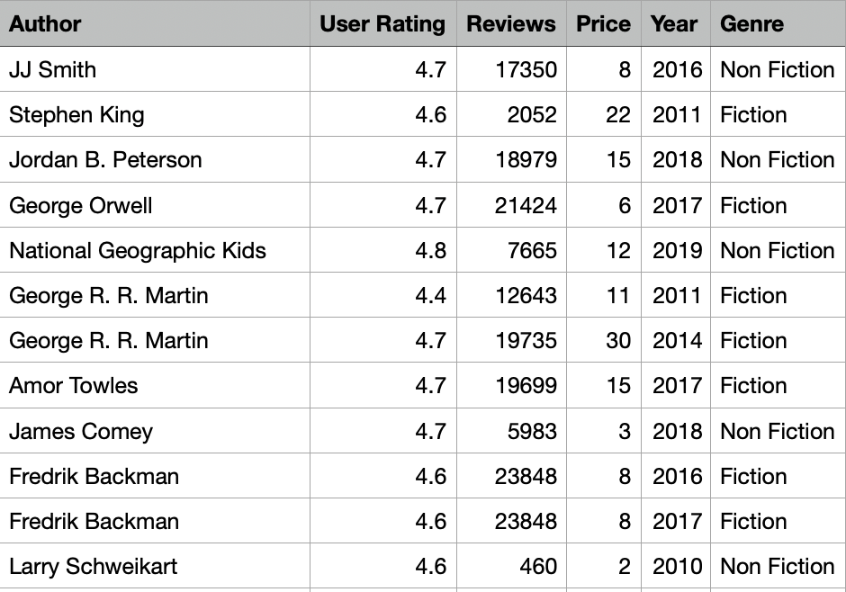
Importing Data Into Python
.csv file: a text file that can store data using “comma separated values”
This is only one of the ways that you might see data, but is very common for beginner projects

Slide 11
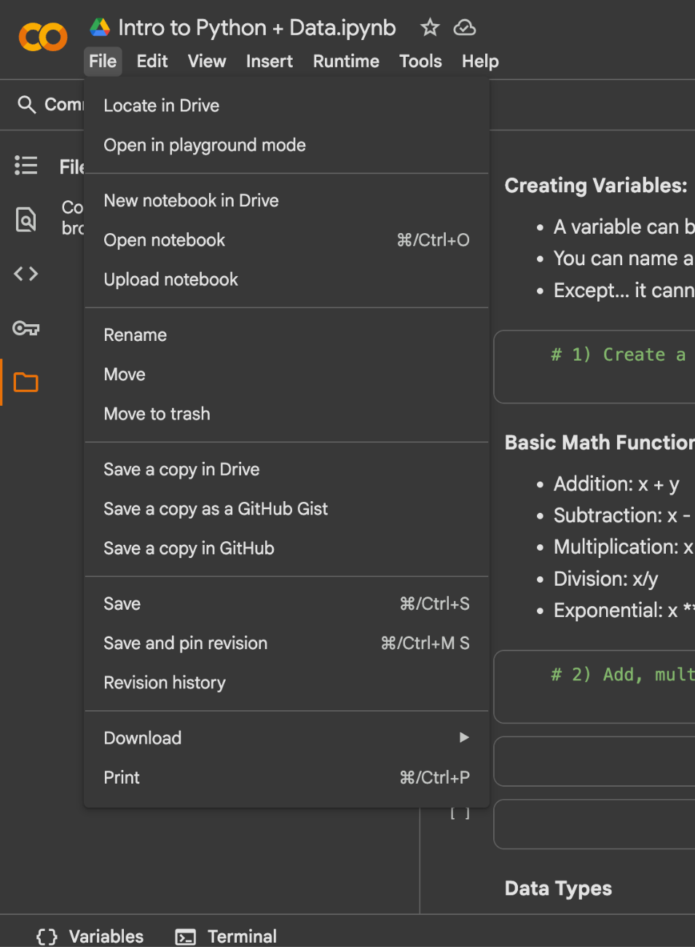
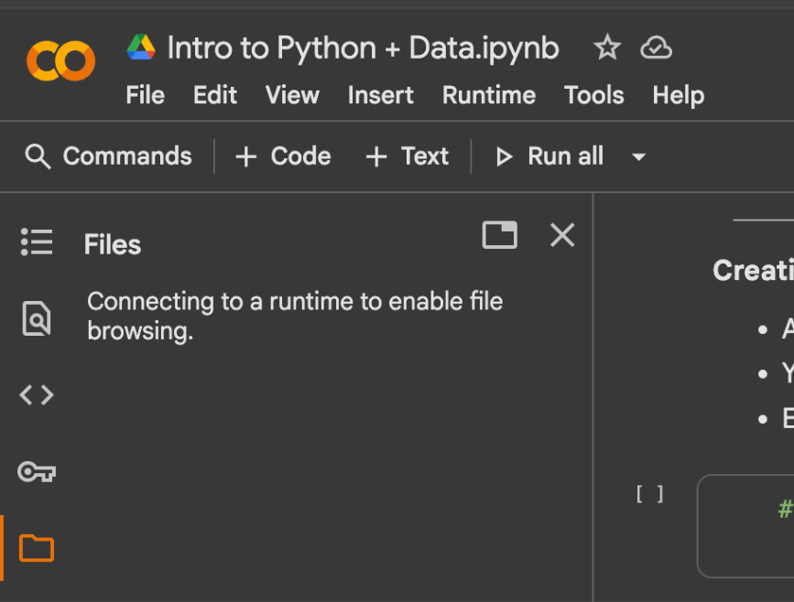
Your Turn!
Worksheet: http://bit.ly/48F4Tsv
Dataset: http://bit.ly/3WsRUT5

